Slide 1
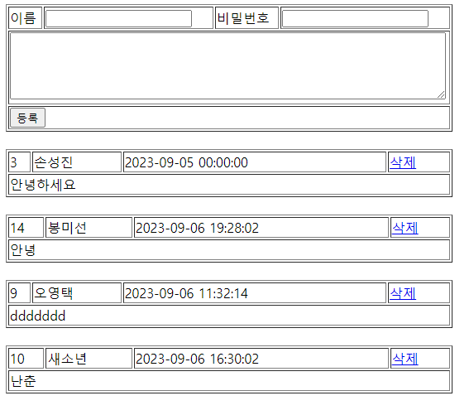
guestbook3 리스트
01
Rqeust(요청)
Tomcat
Request header
파라미터: action=list
Request body
guestbook3
http://localhost:8000/guestbook3/GBC?action=list
contoller(servlet)객체
guestDao 객체
list일때
guestList
..
getGuestList()
rquest
Response(응답)
response
Response header
Response body (html)
*포워드
rquest
addList.jsp
객체
response
Rqeust(요청)
Request header
파라미터: action=list
Request body
어트리뷰트: “gList”, guestList
Response(응답)
DB
Response header
Response body (html)

Slide 2
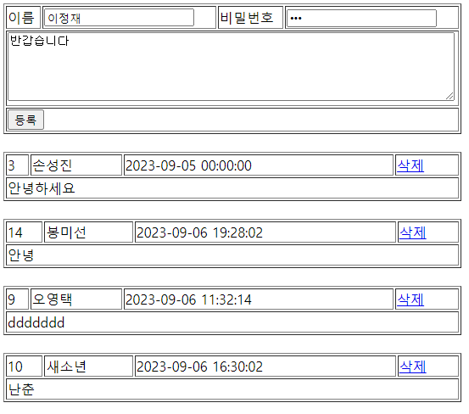
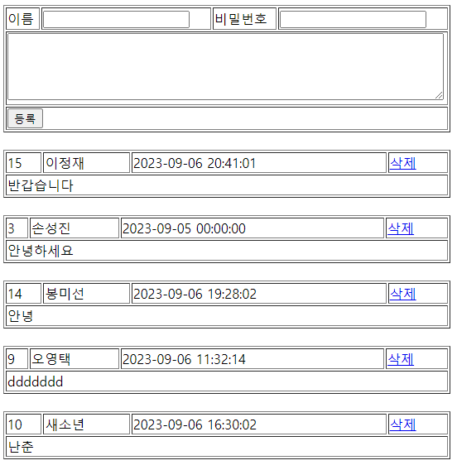
guestbook3 등록
01
Rqeust(요청)
Request header
Request body
(파라미터) name=,password=,content=
Tomcat
guestbook3
contoller(servlet)객체
guestDao 객체
add일때
guestDao
..
guestInsert()
rquest
http://localhost:8000/guestbook3/GBC?action=add
response
guestDao()
Response(응답)
Response header
Response body (리다이렉트코드)
DB

Slide 3
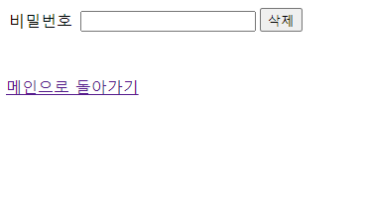
guestbook3 삭제폼
01
Rqeust(요청)
Request header
파라미터: action=dFrom
Request body
파라미터: no=
Tomcat
guestbook3
http://localhost:8000/guestbook3/GBC?action=dFrom
contoller(servlet)객체
guestDao 객체
dFrom일때
guestList
..
rquest
Response(응답)
response
Response header
Response body (html)
*포워드
rquest
dFrom.jsp
객체
response
Rqeust(요청)
Request header
파라미터: action=dFrom
Request body
파라미터: no=
Response(응답)
Response header
Response body (html)

Slide 4
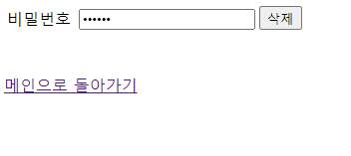
guestbook3 삭제
01
Rqeust(요청)
Request header
Request body
(파라미터): no=,password=
Tomcat
guestbook3
contoller(servlet)객체
guestDao 객체
delete일때
guestDao
..
guestDelete()
http://localhost:8000/guestbook3/GBC?action=delete
rquest
response
Response(응답)
Response header
Response body (리다이렉트코드)
DB

